Slide 1
ZOMATO Data Analysis Portfolio Project
Tanuja Sawant

Slide 2
Data Visualization using Power BI

Slide 3
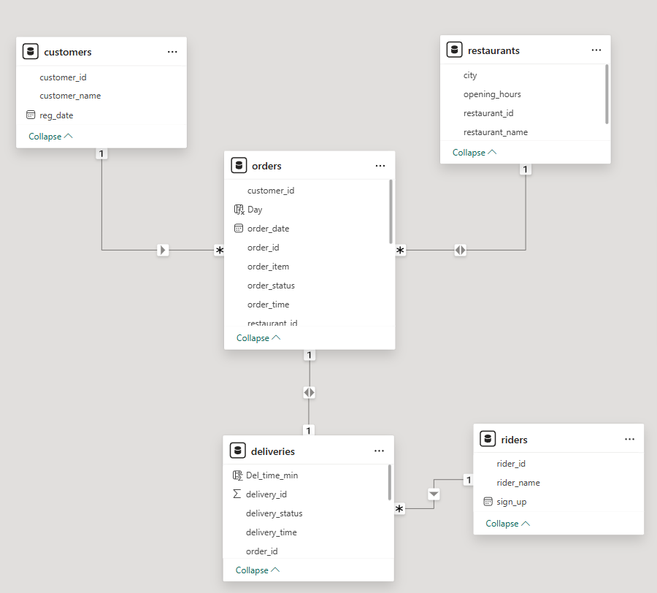
Model View

Slide 4
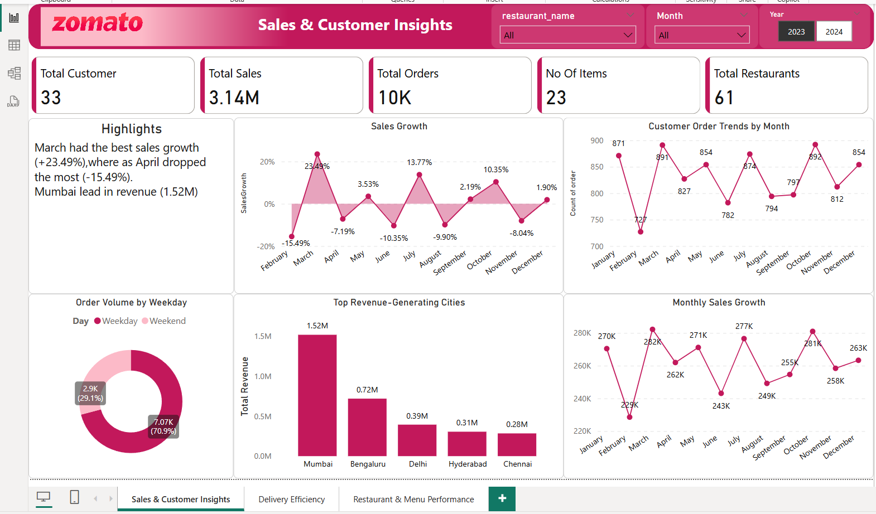

Slide 5
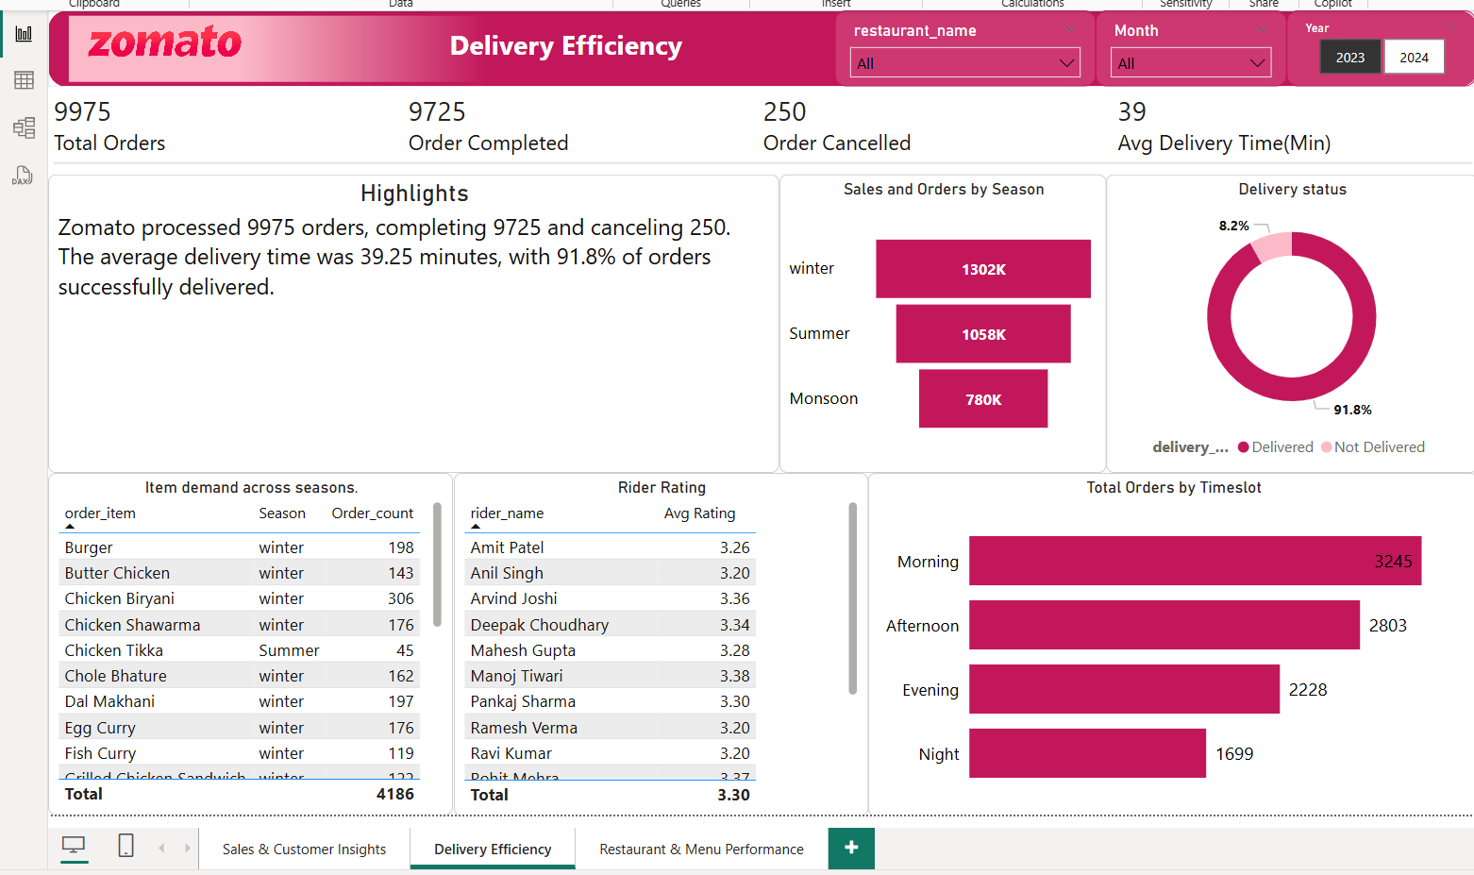

Slide 6
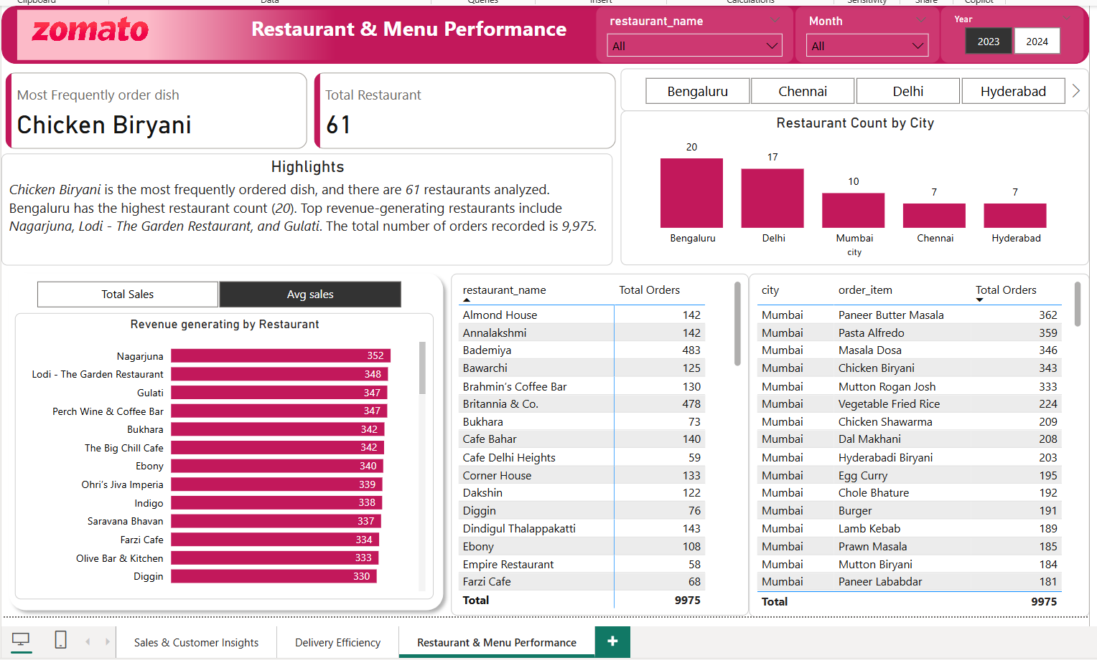

Slide 7
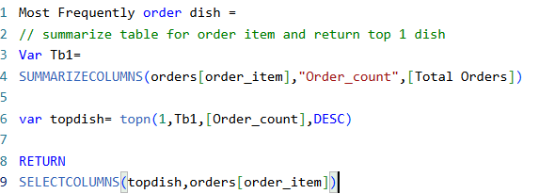




Created Custom Measure

Slide 8
